Slide 1
Techniques for Enhancing User Experience
July 12, 2018

Slide 2
Reimagining and re-envisioning the public library
People
Place
Platform

Slide 3
“The library is first and foremost a place…a place that promotes development in society. It is a family room of a community. That’s the vision, that’s the future. ” Aljtar Badshad Rising to the Challenge: Re-Envisioning Public Libraries, pg. 13

Slide 4
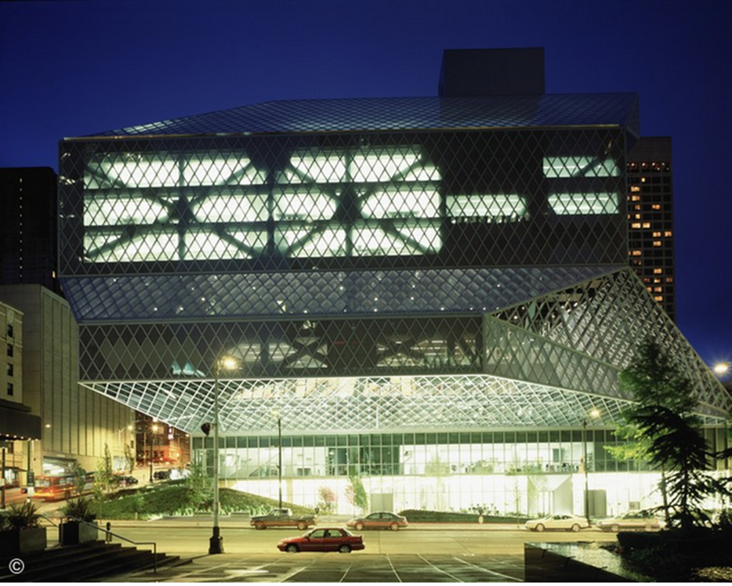
Seattle Public Library
Photograph by Philippe Ruault
archdaily.com/11651/seattle-central-library-oma-lmn

Slide 5
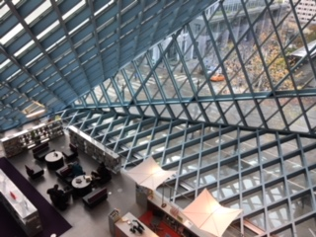
Building design impact users experience.
Seattle Public Library, 2017

Slide 6
Renton Public Library
Photograph by Lara Swimmer

Slide 7
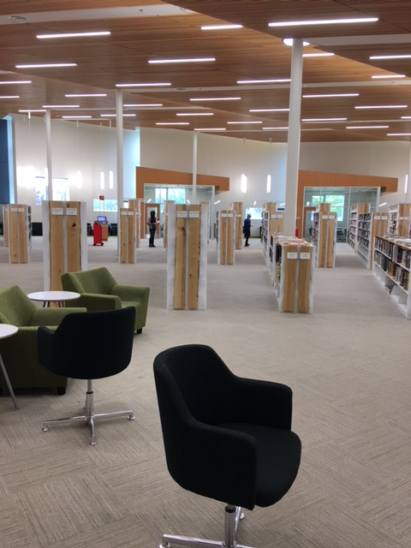
Wasilla Public Library
Open space with
clear sight lines
Notes:
Photo shows how the Wasilla Public Library’s collections are located in the center of the building .

Slide 8
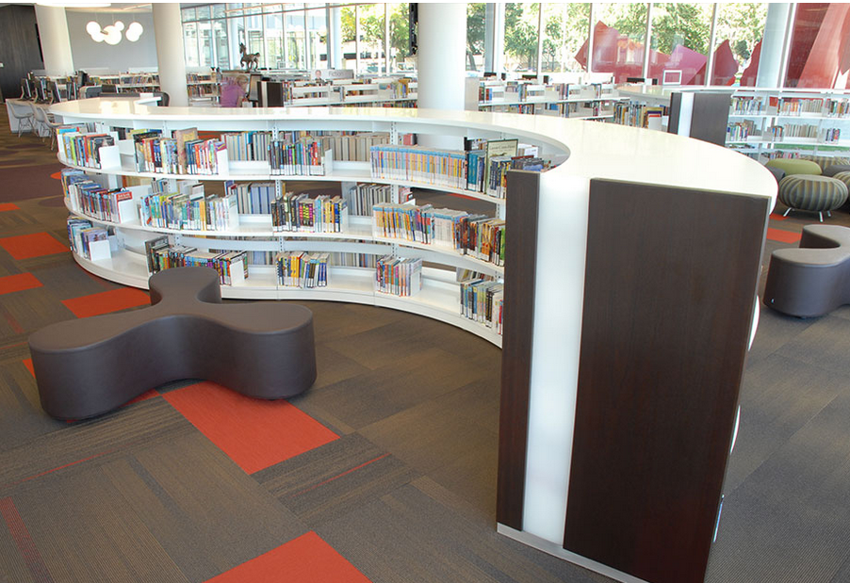
Cedar Rapids Public Library
Natural sunlight and flexible spaces
http://bcilibraries.com/tag/public-library-design-best-practices/

Slide 9
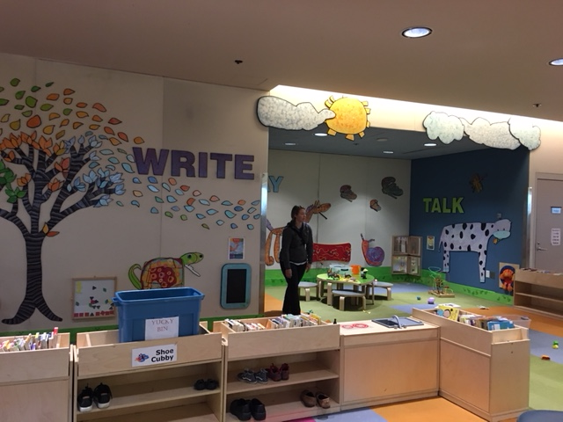
Loussac Library
Creative spaces for active learning

Slide 10
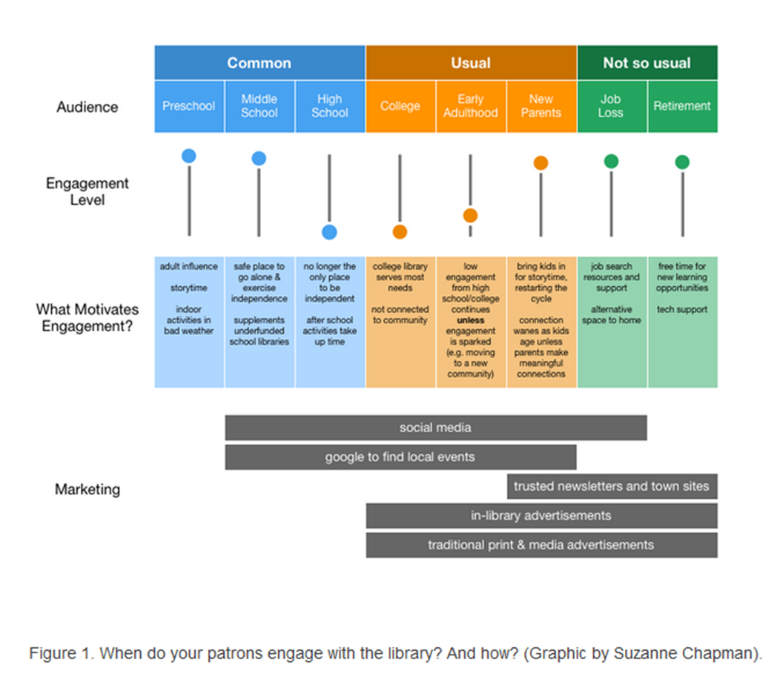
Who is using the public library?
Notes:
Meet them in the moment: engaging public library patrons when it matters most, by Deirdre Costello, Cathleen Keyser
Weave Journal of Library User Experience
https://quod.lib.umich.edu/w/weave/12535642.0001.404?view=text;rgn=main
Does your library layout and design reflect who is using your library?

Slide 11
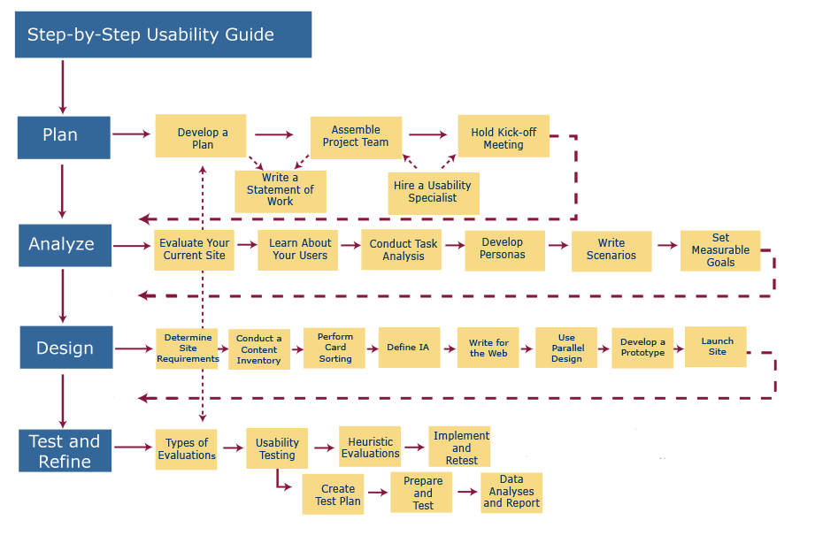
User-Centered Design Process Map
Used in website development
Notes:
https://www.usability.gov/how-to-and-tools/resources/ucd-map.html

Slide 12
Touchpoints
A point of contact or interaction (including encounters where there is no physical interaction) that might alter the way that a customer feels about your product, brand, business or service.
Notes:
https://www.interaction-design.org/literature/article/customer-touchpoints-the-point-of-interaction-between-brands-businesses-products-and-customers

Slide 13
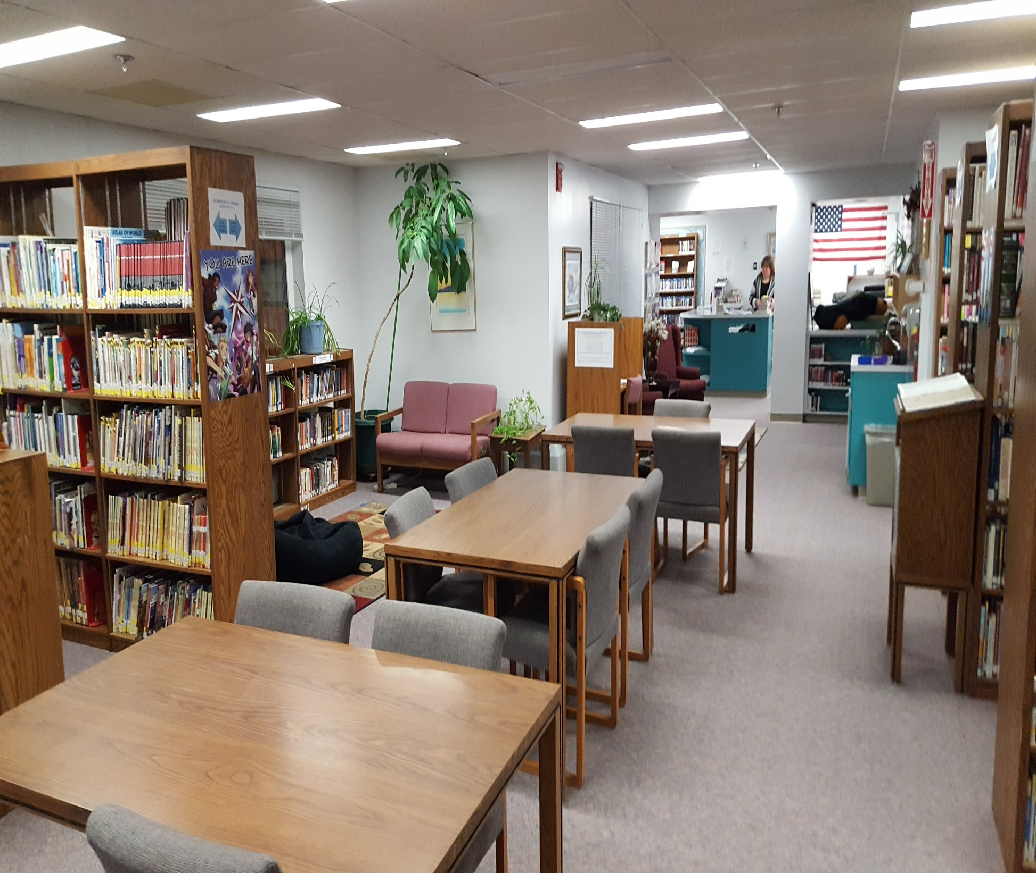
Touchpoint examples
Physical layout
Furniture
Cleanliness
Temperature
Notes:
Touchpoints include the Physical layout of the library
Furniture (uncomfortable chairs)
Customer service (prompt, courteous)
Cleanliness of the library,
Bathroom-does it smell, is it adequately stocked with supplies
Temperature
Lighting
Sounds
Signage

Slide 14
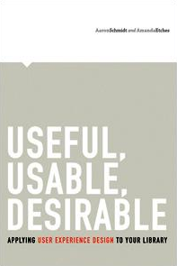
USER Experience (UX) for Libraries
Useful
Usable
Desirable
Notes:
The book, Useful, Usable, Desirable: Applying User Experience Design To Your Library, written by
Aaron Schmidt and Amanda Etches is an excellent introduction in to this new methodology.

Slide 15
First Four Principles of Good Library User Experience Design
You Are Not Your User
2. The User Is Not Broken
3. Requires Research
4. Requires Empathy

Slide 16
Final Four Principles of Good Library User Experience Design
5. Must Be Easy Before It Can Be Interesting
6. Is Universal
7. Is Intentional
8. Is Holistic

Slide 17
Attitudinal Research
Designed to measure how a consumer “feels” about something.
Focus groups
Interviews
Surveys
Notes:
http://www.businessdictionary.com/definition/attitudinal-data.html

Slide 18
Behavioral Research
Behavioral data refers to information produced as a result of actions
Contextual Inquiry
Journey Mapping
Usability Testing

Slide 19
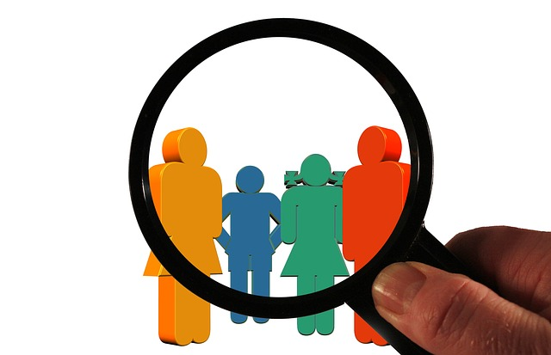
Focus Groups

Slide 20
Interviews

Slide 21
Interview template
Service.designtoolkit.org
Notes:
On the slide is an interview template freely available for download from the Service Design Toolkit.

Slide 22
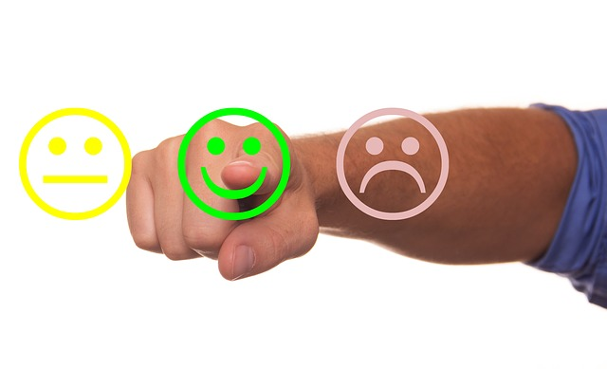
Surveys

Slide 23
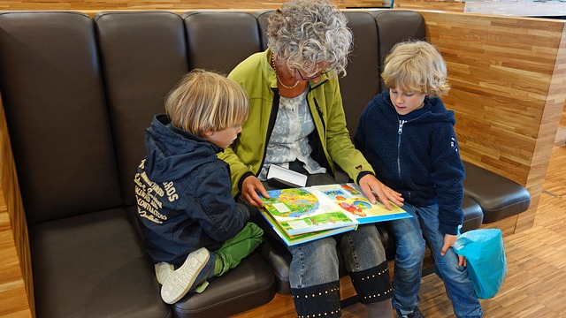
Contextual Inquiry

Slide 24
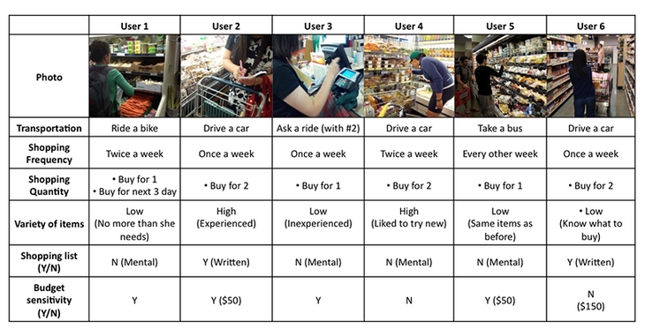
Contextual Inquiry-example
Created by Sophia Lay
http://people.ischool.berkeley.edu/~sophia.lay/01-portfolio/index.html

Slide 25
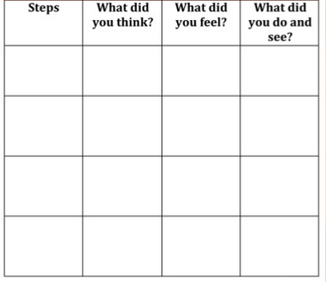
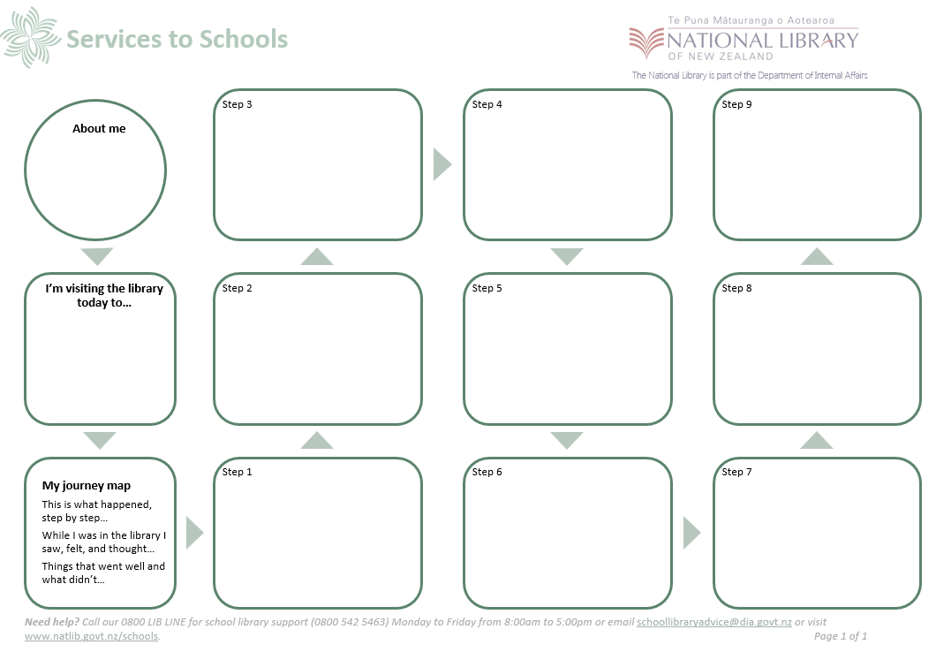
Journey Mapping-template examples
Customer Journey Mapping for Libraries
National Library New Zealand
Notes:
One the slide are two examples of journey maps. The first one is from Robin O’Hanlon’s slide share presentation, Customer Journey Mapping for Libraries, https://www.slideshare.net/RobinOHanlon/customer-journey-mapping-for-libraries
The other is from the National Library of New Zealand's Journey Mapping for school library design websites.
https://natlib.govt.nz/schools/school-libraries/leading-and-managing/managing-your-school-library/evidence-based-school-library-practice/journey-mapping-for-school-library-design

Slide 26
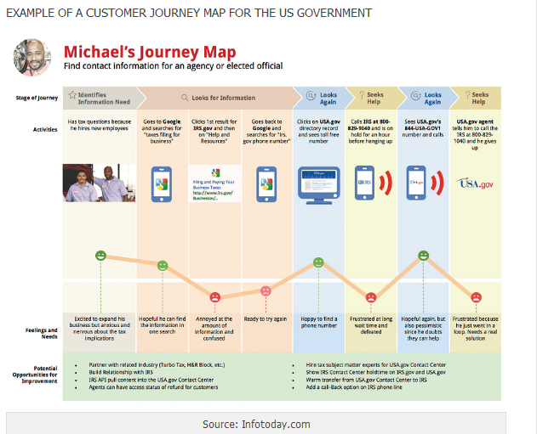
Journey Map-example
User
Purpose
Stages of Journey
Activities
Feelings (Pain points)
Opportunities
Notes:
The journey map example on the slide comes from the How to use customer journey mapping to guide your content strategy post, on the HummingBuzz Copywriting and digital marketing blog.
Michaels’ journey map clearly shows several pain points Michael experienced which ultimately led him to give up his search for tax information from the IRS.gov website.
https://hummingbuzz.com.au/customer-journey-mapping-guide-content-strategy/

Slide 27
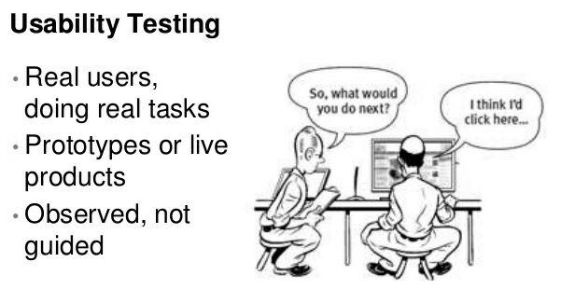
Usability Testing
https://www.quora.com/What-is-usability-testing
Notes:
https://www.quora.com/What-is-usability-testing
Jenny Todavchych, Product Manager EasyQA

Slide 28
Other Research Techniques
Personas
Empathy Maps
A/B Testing
Five-Second Tests

Slide 29
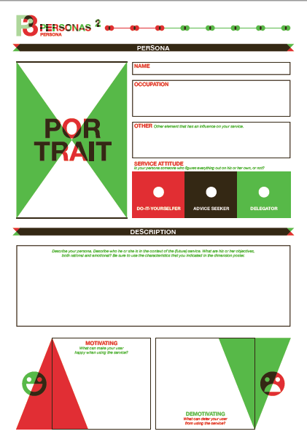
Personas
Caitlin
Part-time barista
20 years old
Lives with her parents
Service.designtoolkit.org

Slide 30
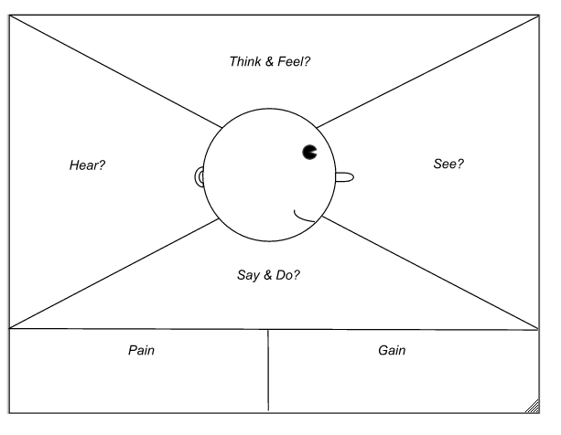
Empathy Map
Originally created by David Gray
www.solutionsiq.com/resource/blog-post/what-is-an-empathy-map/

Slide 31
Empathy maps
Created by Paul Boag
https://boagworld.com/usability/adapting-empathy-maps-for-ux-design

Slide 32
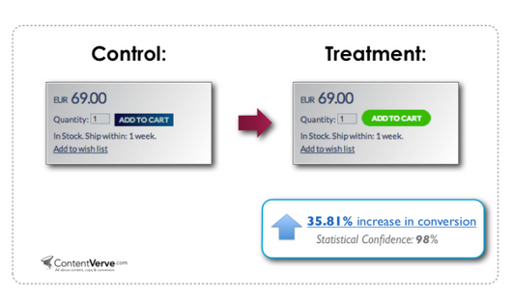
A/B Testing
https://unitid.nl/english/introduction-to-ab-testing-and-5-test-examples/
Notes:
The example on the slide is from the Unitid website and demonstrates how shape and color can influence users behavior.

Slide 33
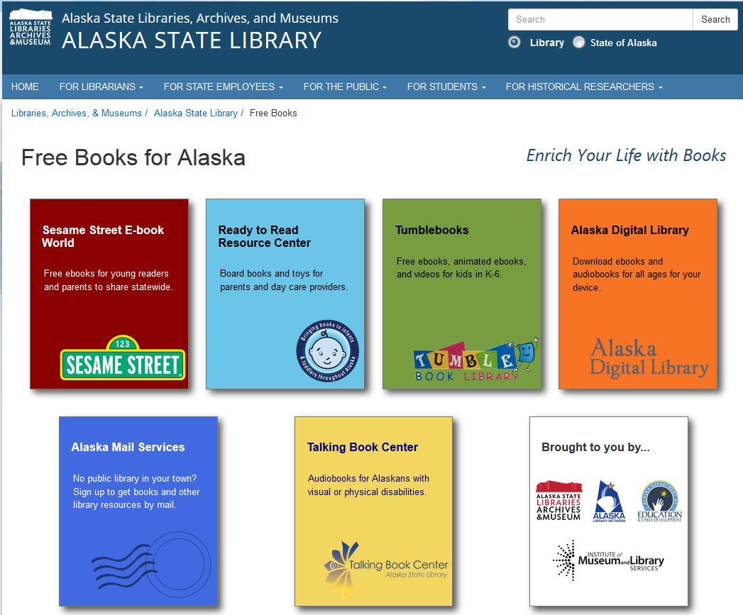
Five-Second Test
books.alaska.gov
Notes:
A five-second test is where you show testers a webpage for five seconds.

Slide 34
Then ask them to recall what they remember about the page.

Slide 35
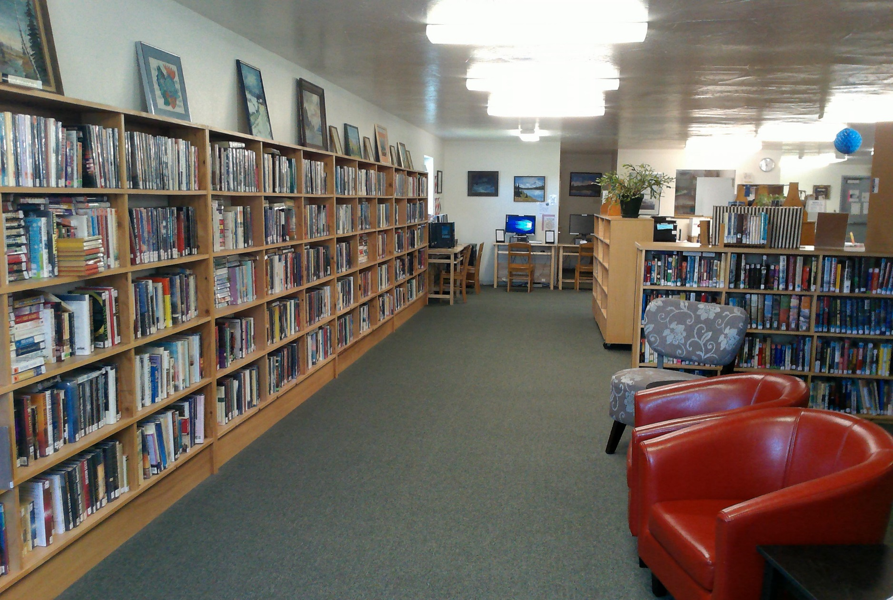
Example 1
Does your library furniture support users needs?
Research Methods:
Contextual Inquiry
Survey

Slide 36
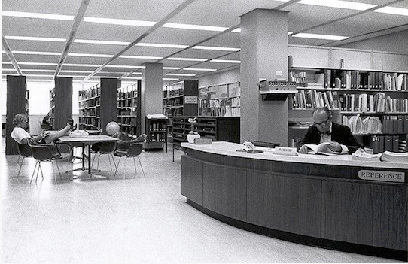
Example 2
Do you think this physical desk looks approachable and friendly?
Yes No
The Library reference desk, 1960s. University Archives and Special Collections
http://www.library.fullerton.edu/about/history.php

Slide 37
Example 3
Can a 1st time visitor easily locate all the areas of your library?

Slide 38
Sources 1
Garmer, A.K. Rising to the Challenge: Re-Envisioning Public Libraries. Aspen Institute, 2014.
Better By Design: an Introduction To Planning and Designing a New Library Building Ayub Khan - Facet Publishing - 2009
Seattle Central Library / Oma + Lmn https://www.archdaily.com/11651/seattle-central-library-oma-lmn
Public Library Facilities for the Future created by Margaret Sullivan Studio for the Sno-Isle Libraries

Slide 39
Sources 2
Lushington, N. (2002). Libraries designed for users: A 21st century guide. New York: Neal-Shuman.
Gander, K. (2016, May 16). Terrible architecture is making you depressed. Retrieved from https://www.independent.co.uk/life-style/design/how-architecture-uses-space-light-and-material-to-affect-your-mood-american-institute-arc
Modern Libraries Around the World. (n.d.). Retrieved July 11, 2018, from http://bcilibraries.com/tag/public-library-design-best-practices/

Slide 40
Sources 3
Customer Touchpoints - The Point of Interaction Between Brands, Businesses, Products and Customers. (n.d.). Retrieved July 11, 2018, from https://www.interaction-design.org/literature/article/customer-touchpoints-the-point-of-interaction-between-brands-businesses-products-and-customers
Schmidt, A., & Etches, A. (2014). Useful, usable, desirable: Applying user experience design to your library. Chicago: ALA Editions.
What is attitudinal data? definition and meaning. (n.d.). Retrieved from http://www.businessdictionary.com/definition/attitudinal-data.html

Slide 41
Sources 4
Woodward, J. A. (2009). Creating the customer-driven academic library. Chicago: American Library Association
Namahn, P. V. (n.d.). Down­loads. Retrieved July 11, 2018, from http://www.servicedesigntoolkit.org/downloads.html
Sophia Lay - UX Designer. (n.d.). Retrieved July 11, 2018, from http://people.ischool.berkeley.edu/~sophia.lay/01-portfolio/index.html
O'Hanlon, R. (2015, November 22). Customer Journey Mapping for Libraries. Retrieved July 11, 2018, from https://www.slideshare.net/RobinOHanlon/customer-journey-mapping-for-libraries

Slide 42
Sources 5
How to use customer journey mapping to create your content strategy. (2018, May 09). Retrieved July 11, 2018, from https://hummingbuzz.com.au/customer-journey-mapping-guide-content-strategy/
Dam, R., & Siang, T. (n.d.). Personas – A Simple Introduction. Retrieved July 11, 2018, from http://www.interaction-design.org/literature/article/personas-why-and-how-you-should-use-them
What Is an Empathy Map? (n.d.). Retrieved July 11, 2018, from http://www.solutionsiq.com/resource/blog-post/what-is-an-empathy-map/

Slide 43
Sources 6
Adapting empathy maps for UX design. (2017, July 19). Retrieved July 11, 2018, from https://boagworld.com/usability/adapting-empathy-maps-for-ux-design
A/B Testing Beginner's Guide with A/B Test Examples. (n.d.). Retrieved July 11, 2018, from https://unitid.nl/english/introduction-to-ab-testing-and-5-test-examples/
Costello, D., & Keyser, C. (2016). Meet Them in the Moment: Engaging Public Library Patrons When It Matters Most. Weave: Journal of Library User Experience, 1(4). doi:10.3998/weave.12535642.0001.404

Slide 44
Sources 7
Journey mapping for school library design. (n.d.). Retrieved July 11, 2018, from https://natlib.govt.nz/schools/school-libraries/leading-and-managing/managing-your-school-library/evidence-based-school-library-practice/journey-mapping-for-school-library-design
User-Centered Design Process Map. (2013, December 18). Retrieved July 11, 2018, from https://www.usability.gov/how-to-and-tools/resources/ucd-map.html

Slide 45
Questions?
Julie M. Niederhauser
Public Library Coordinator
Julie.Niederhauser@Alaska.gov
library.alaska.gov

