Slide 1
Grant Writing
Interlibrary Cooperation Grant Explained
October 11, 2018

Slide 2
Statutes
ALASKA STATUTES: Article 03 Library Assistance Grants
Sec. 14.56.300. Library assistance grant program.
There is established in the department a library assistance grant program. From legislative appropriations, the department shall make grants to eligible libraries for public library operations, for interlibrary cooperation, or for regional library services.

Slide 3
4 AAC 57.065. Interlibrary cooperation grants
The interlibrary cooperation grant program is competitive. The division shall make an interlibrary cooperation grant to a library to promote or support
sharing of resources;
cooperative services with another library;
innovative programs for the delivery of library services; or
training or other programs that strengthen library services.

Slide 4
Public libraries that receive the Public Library Assistance grant are eligible to apply for the Interlibrary Cooperation Grant.

Slide 5
The deadline for submitting the ILC grant is April 1st.

Slide 6
Grants for Alaska Libraries and Schools
Grant application
Budget revision form
Finance worksheet
Final report form

Slide 7
Writing the Grant
Start with a real problem
Work with others to formulate a solution
What will your organization contribute (staff, supplies, space) to the solution?
What will you need to spend $$$ on?
What needs to happen when?
How will you know that you have made an impact?

Slide 8
Problem
A new housing development built near the library has increased the number of Middle School students using the library afterschool. Every weekday at 3:10 sharp, a group of up to 15+ middle schoolers show up at the library to get on the public computers and just hang out. Generally, they behave themselves but occasionally this group of tweens can get loud and rowdy. Several of these students have asked the library for art materials so they can draw or make other paper crafts but the library doesn’t have the funds to supply the tweens with these materials. A retired art teacher has offered to donate her time to lead a weekly afterschool art program in the library’s meeting room but has asked the library to provide the necessary supplies.
Notes:
Example of a problem

Slide 9
What’s the problem?

Slide 10
Problem restated
Bored middle schoolers looking for something to do after school. The library currently doesn’t have the staff or funding to offer an afterschool program.

Slide 11
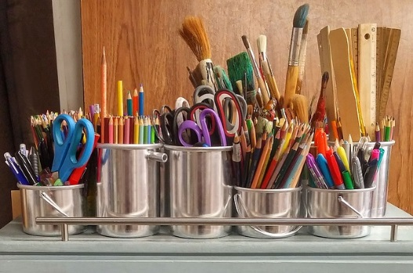
Solution
Seeking advice on how to address the large group of unsupervised middle school students coming to the public library after school, library staff reached out to the middle school librarian. She mentioned that due to budget cuts the school no longer provides an art program for students. Together they brainstormed the possibility of the public library offering a weekly afterschool art program, some potential facilitators, and the types of activities that could be offered.

Slide 12
Library grant project
Library staff then reached out to a retired arts educator, who is willing to offer a free weekly afterschool art program September thru January on Wednesday’s from 3:30 pm to 5:30 pm. To ensure the quality of the program she is requesting the program be limited to 10 students per session. She is willing to donate her time to lead the program and help each student create a personal art portfolio but has asked that the library purchase the art materials required for the students use in the program.
The library has also agreed to publicize the program, provide use of the library meeting room, manage the registration of students and write a grant for funding to purchase the art materials.
Notes:
What will the library contribute (staff, supplies, space) to the solution?
What do they need to spend $$$ on?
Who can you partner with to work on this problem?
What needs to happen first-write a grant for the supplies
Why is this important to the library/community? The school is no longer offering an art program, children are asking for art supplies
How will you have made an impact? (this question remains to be answered)

Slide 13
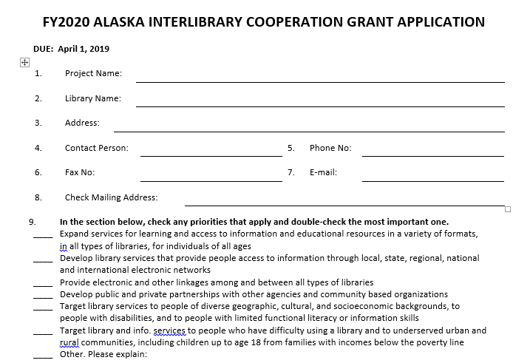
ILC Grant Application

Slide 14
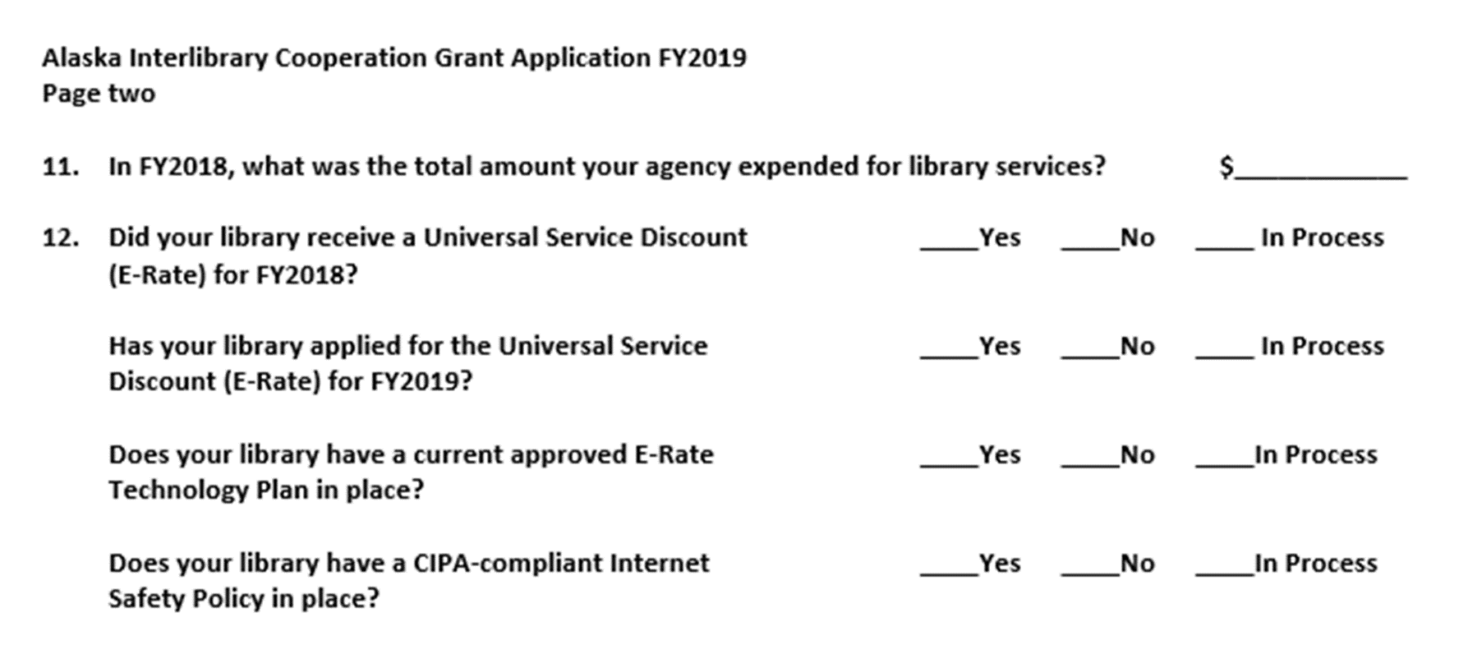
Questions 11 & 12
Notes:
Question 11. If you don’t know what your total operating expenditures were for your library, you can get the information from the Alaska Public Library Report System https://library.alaska.gov/dev/plreport.html
You will need your username and password to log into Alaska Public Library Report System. Once in, scroll down to Part 5: Operating Expenditures and
Then to item 5-4 Total Operating Expenditures.
If you are unsure how to answer the E-rate questions- you can always reach out to Valerie Oliver, our E-Rate Consultant. Her contact information is located on the Alaska State Library homepage https://library.alaska.gov/dev/libdev.html

Slide 15
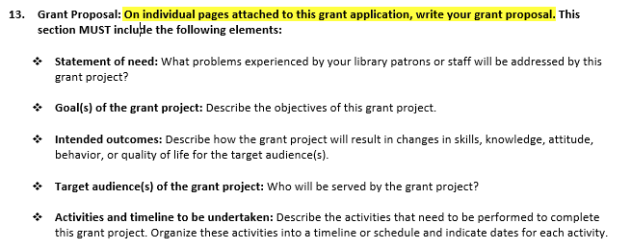
Question 13 Grant Proposal

Slide 16
Statement of need
Use the who, what, where, when, why and how format to create a concise statement that includes all of the pertinent information.
Use facts or research for impact
Keep it simple and concise

Slide 17
Intended goal
A goal is a broad primary outcome.
GOAL:
During the months of September thru January, the library will offer a free weekly afterschool art program for middle school students on Wednesday’s from 3:30 pm to 5:30 pm. Each session will be limited to 10 students. Participating students will create a personal art portfolio over the course of the program.

Slide 18
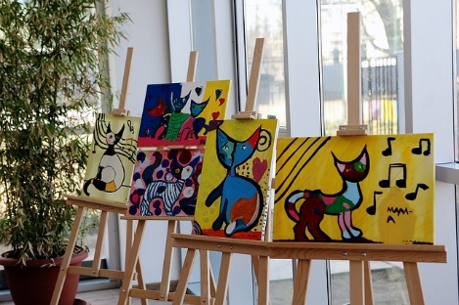
Goal of the grant project
A strategy is the approach you take to achieve a goal.
An objective is a measurable step you take to achieve a strategy.
Objective: By the end of January, the library will provide students ages 11-14, with 15 weekly 2 hour afterschool art session that will introduce them to art concepts, improve their fine motor skills and teach them how to create an art portfolio.

Slide 19
Intended outcomes
Students participating in the art program will become more confident talking about artwork.
Students participating in the art program will improve their fine motor skills-drawing, sketching and brush strokes.
Students participating in the art program will create a personal art portfolio consisting of six works of art.

Slide 20
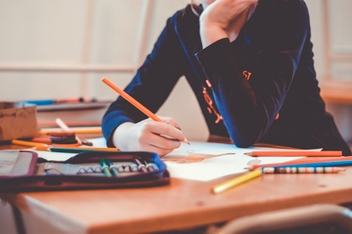
Target audience
Middle school students (11-14 years of age)

Slide 21
Activities & timeline to be undertaken
July: Preplanning & Ordering Supplies
Work with art instructor to develop art curriculum
Order art supplies and storage equipment
Reserve meeting rooms
August: Publicize & Registration
September: Afterschool Program Starts
November: Plan Student Art Show
December: Conduct Evaluations & Student Art Show

Slide 22
Budget details

Slide 23
Justification of budget line items
Item | Cost | Total
Publicity (Printing Fliers ) | $100.00 | $100.00
Art Supplies (include description of supplies) $95.00 per student | $95.00 x 10 students = 950.00 | $950.00
Storage equipment for art supplies (include description) | $80.00 | $80.00
Art Show Supplies (include description) | $30.00 | $30.00
Total Grant Funds Needed |  | $1160.00
In-kind contribution: Library staff will donate 50 hours x $12.00 per hour= $600.00 (writing and managing grant, creating posters, ordering supplies, registering students, creating and conducting evaluation). Library will donate use of the meeting room (15 days for 2 hours at $10.00 per hour = $600.00
Art instructor will donate 45 hours x $25.00 per hour= $1125.00 planning program, providing instruction and evaluating student art work . Total in-kind: $2,325.00

Slide 24
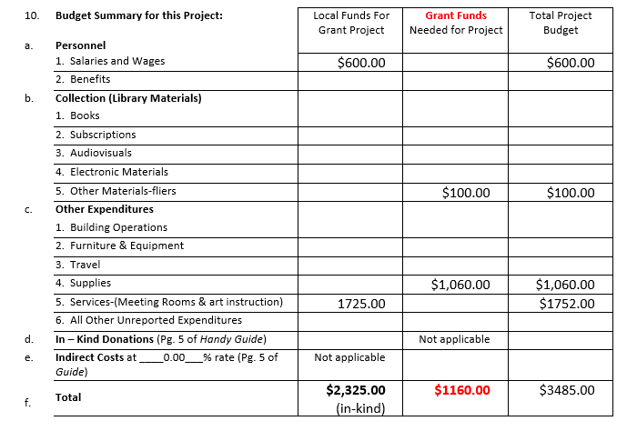
Budget Summary for this Project:

Slide 25
DUNS Number
A DUNS number is a unique nine-character number used to identify your organization. The federal government uses the DUNS number to track how federal money is allocated.
How to Register for a DUNS Number
If your organization does not yet have a DUNS number, or no one knows it, visit the Dun & Bradstreet (D&B) website or call 1-866-705-5711 to register or search for a DUNS number.
https://www.grants.gov/applicants/organization-registration/step-1-obtain-duns-number.html

Slide 26
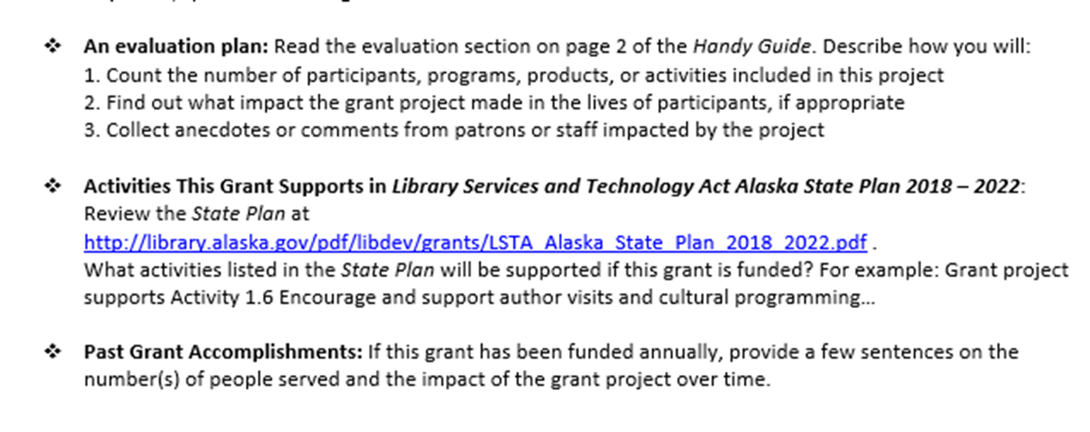
Evaluation Plan & Activities

Slide 27
An evaluation plan
By January 2020, 90% of the students participating in the arts program will report that they are more confident talking about artwork.
By January 2020, 90% of students participating in the arts program will report that their fine motor skills- drawing, sketching and brush strokes have improved .
By January 2020 , 85% of the students will have created a personal art portfolio consisting of six works of art.

Slide 28
Library Services and Technology Act Alaska State Plan 2018-2022
https://library.alaska.gov/public/board.html
Notes:
.

Slide 29
Goals

Slide 30
Check your evaluation plan
By January 2020, 90% of the students participating in the arts program will report that they are more confident talking about artwork.
By January 2020, 90% of students participating in the arts program will report that their fine motor skills- drawing, sketching and brush strokes have improved .
By January 2020 , 85% of the students will have created a personal art portfolio consisting of six works of art.

Slide 31
Final Questions

Slide 32
Continuation plan
Review
Refine
Renew

Slide 33
Dissemination plan
Suggestions:
An article in Newspoke: the newsletter of the Alaska Library Association
A poster session during the AkLA Conference
A webinar (Public Librarians Chat is always looking for presenters)
A presentation during the AkLA Conference

Slide 34
Letters of Support
A letter from the Middle School Principal
A letter from School Librarian

Slide 35
Check the following before submitting
Check you math
Spelling
Logic of the time line
Project Goal

Slide 36
Contact Slide
Julie M. Niederhauser
Public Library Coordinator
Julie.Niederhauser@Alaska.gov
(907) 465-2916
library.alaska.gov

